Slide 1
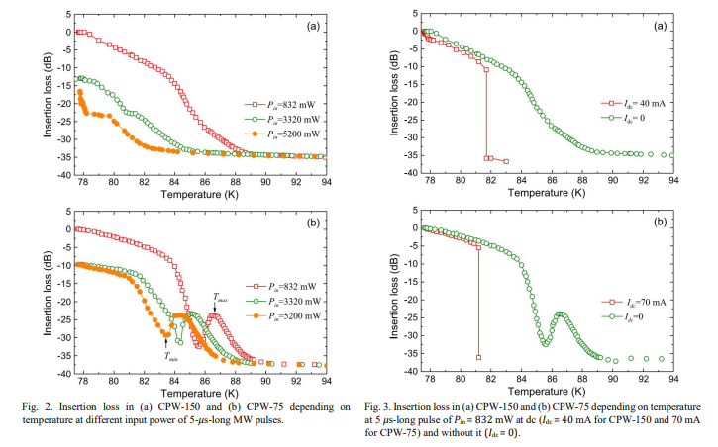
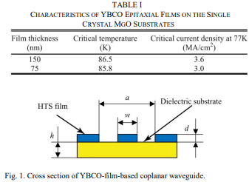
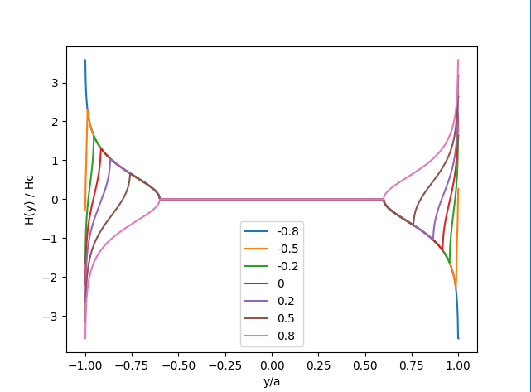
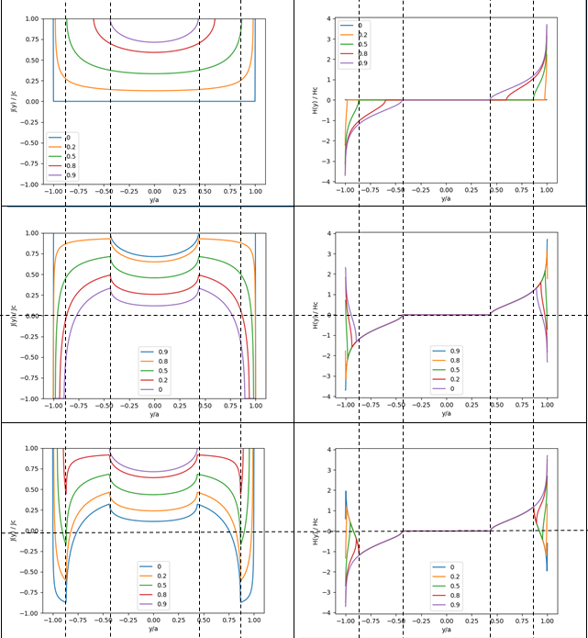
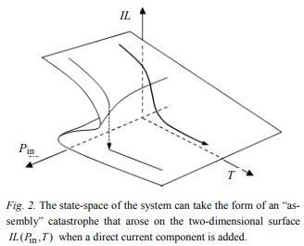
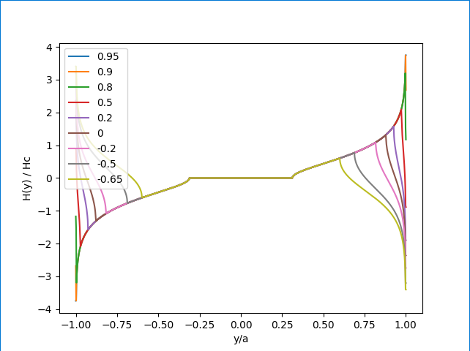
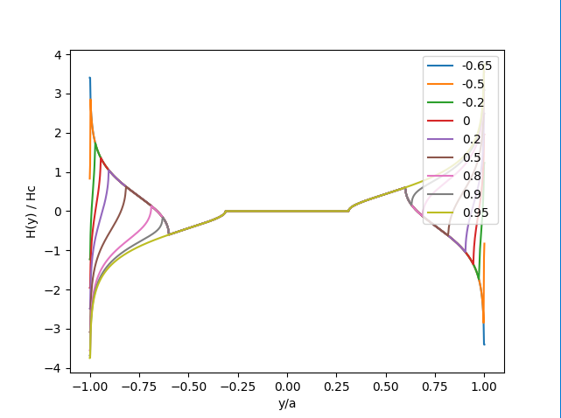
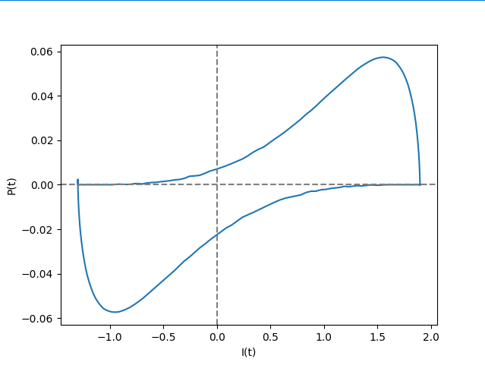
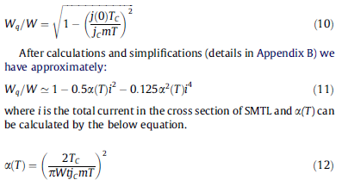
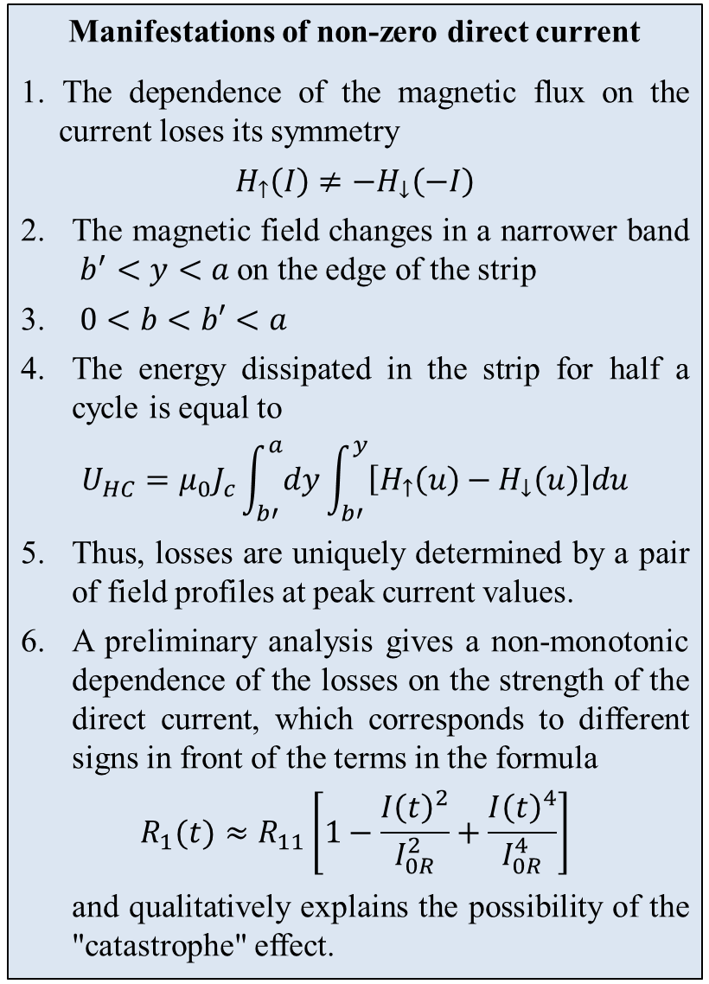


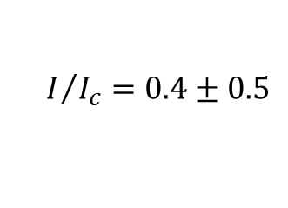
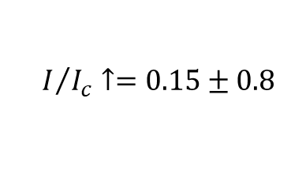
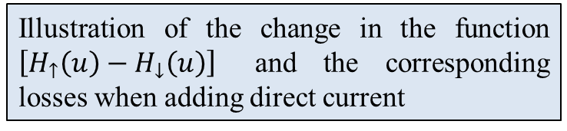
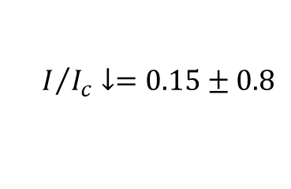
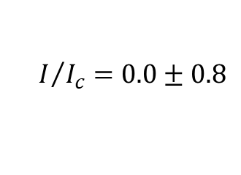
Analysis of the influence of vortex dynamics on the possibility of an avalanche-like transition of a microwave nonlinear HTS transmission line into a dissipative state
S. I. Melnyk O.Ya. Usikov Institute for Radiophysics and Electronics NAS of Ukraine melnyksergiy72@gmail.com
In an experimental study of the properties of a microwave (MW) transmission line of the coplanar waveguide type based on high-temperature superconductors (HTS) at certain values ​​of the input power 𝑃_{in} and direct current (DC) 𝐼_{dc}, the effect of strong (abrupt) changes in MW losses at a certain waveguide temperature 𝑇 < 𝑇c, where 𝑇c is the critical temperature, was discovered [1].
The nature of the studied behavior of the MW loss dependencies allows us to consider the abrupt changes in the properties of a nonlinear HTS transmission line as a "catastrophe" of the "fold" type and to use the methodological and mathematical apparatus of the "catastrophe" theory to describe it [2].
The experimental dependences IL (T ), obtained for a given Pin and
the absence of a direct current (Fig. 1), exhibit distortions in the
temperature range 82–90 K. This could lead to the effect of a catastrophe
in the case when the film temperature T is a state parameter and the
insertion loss IL is a control parameter. But we do not yet see the
possibilities for the physical realization of this effect.
Instead, the effect of the direct current component on the nature of the
dependence IL T( ) was investigated in experiments. The abrupt change
in IL at some (critical) values of T or dc I suggests that the shape of the
IL (T ) dependence is distorted, as shown in Fig. 2.
It was shown that taking into account the fourth-degree term in the expansion of the dependence of the HTS properties on current and changing the sign of the quadratic term allows us to qualitatively explain the experimentally observed effects.
$$R_{1}(t)≈R_{11}\left[1−\frac{{I\left(t\right)}^{2}}{I_{0R}^{2}}+\frac{{I\left(t\right)}^{4}}{I_{0R}^{4}}\right]$$
The description of the vortex dynamics arising in HTS thin-film under the influence of an alternating magnetic field is usually carried out within the framework of the phenomenological model proposed by Bean [4]. In this report, we analyzed the possibility of such a generalization of the Bean model, as well as the possibility of the influence of the vortex structure dynamics on the nature of the nonlinear 𝑅(𝐼) dependence .
Generalization concerns the presence of a direct current along the waveguide.
The direct current consists of induction currents caused by the microwave field. Within the framework of the Bean model, this leads to the fact that the boundaries of the vortex and vortex-free zones oscillate asymmetrically (with a phase shift) in cycle.
The presence of a constant component of the current leads to the appearance of an additional pair of bands with a "frozen" vortex structure, which affects the dynamically changing distribution of currents in the edge regions, but does not participate in the dissipation of microwave energy.
Analytical and numerical methods for calculating the dynamics of the distribution of the vortex structure and induced currents in this case allow us to determine the absorption coefficient in each of the strip sections by the usual method (as the area of ​​the magnetization hysteresis loop).
Preliminary calculation results show that, with some coincidence of parameters, the nature of the effective nonlinearity in the phenomenological record of the dependence of resistance on current has the character of a "fold".
$$I/{I_{c}}=0.4±0.5$$
$$I/{I_{c}}=0.0±0.8$$
Manifestations of non-zero direct current
1. The dependence of the magnetic flux on the current loses its symmetry
$$H_{↑}\left(I\right)≠−H_{↓}\left(−I\right)$$
The magnetic field changes in a narrower band $b^{′}<y<a$ on the edge of the strip
$0<b<b′<a$
The energy dissipated in the strip for half a cycle is equal to
$$U_{HC}=μ_{0}J_{c}\int_{b′}^{a}{dy}\int_{b′}^{y}{\left[H_{↑}\left(u\right)−H_{↓}\left(u\right)\right]du}$$
Thus, losses are uniquely determined by a pair of field profiles at peak current values.
A preliminary analysis gives a non-monotonic dependence of the losses on the strength of the direct current, which corresponds to different signs in front of the terms in the formula
$$R_{1}(t)≈R_{11}\left[1−\frac{{I\left(t\right)}^{2}}{I_{0R}^{2}}+\frac{{I\left(t\right)}^{4}}{I_{0R}^{4}}\right]$$
and qualitatively explains the possibility of the "catastrophe" effect.
$$I/{I_{c}}↓=0.15±0.8$$
In [3], an approximation of existing nonlinearity models for the case of strong and weak currents by a fourth-degree polynomial is proposed.
However, negative values ​​of both nonlinear terms do not provide the occurrence of a "fold" type feature. Therefore, we can assume the presence of an additional physical factor that provides the occurrence of an inflection point on the $R_{1}(I)$ dependence.
Such a factor may be a feature of the vortex structure dynamics in a microwave field, which is not taken into account in the previously considered models.
$$I/{I_{c}}↑=0.15±0.8$$
Characteristic type of current and field dependences in the cross section of the strip in the presence of direct current comparable in amplitude to alternating current
Type of hysteresis loop of power losses in one cycle
Illustration of the change in the function $\left[H_{↑}\left(u\right)−H_{↓}\left(u\right)\right]$ and the corresponding losses when adding direct current
The work was performed within the framework of Agreement No 4.5/25-Π on Jan. 1, 2025 between National Academy of Sciences (NAS) of Ukraine and O. Ya. Usikov IRE of NAS of Ukraine.
[1] N. Cherpak, A. Lavrinovich, A. Gubin, S. Vitusevich. Microwave quenching in DC-biased coplanar waveguide based on YBa2Cu3O7−𝛿 thin film. IEEE Trans. on Appl. Supercond. 26, 1501204 (2016).
[2] Melnyk S.I., Melnyk S.S., Lavrinovich A.A., Cherpak N.T, Catastrophe Theory in the Phenomenological Description of the Avalanche Effect in Dc-Biased Microwave HTSC Transmission Lines: Superconductors at Microwave Frequencies and Flux Flow Instabilities. Fiz. Nizk. Temp. 2020, 46, 433-440.
[3] Javadzadeh, S.M.H., Farzaneh, F., Fardmanesh, M.: ‘Modeling of unusual nonlinear behaviors in superconducting microstrip transmission lines’, Phys. C Supercond., 2013, 486, pp. 37–42
[4] Brandt Ernst Helmut and Mikhail Indenbom, Type-II-superconductor strip with current in a perpendicular magnetic field. Phys. Rev. B 48, 12893 – Published 1 November, 1993. DOI: https://doi.org/10.1103/PhysRevB.48.12893

